Slide 1


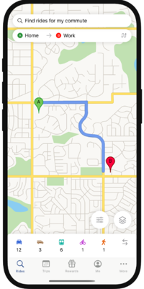
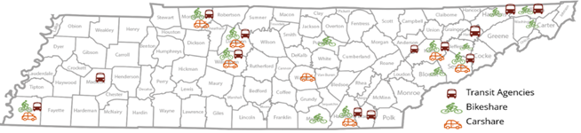
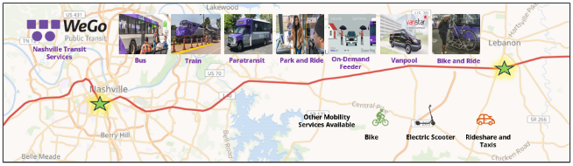
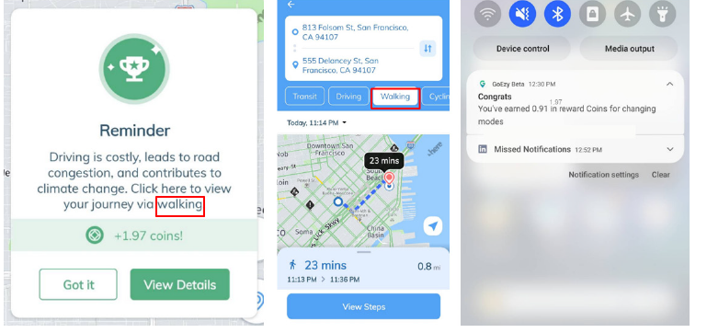
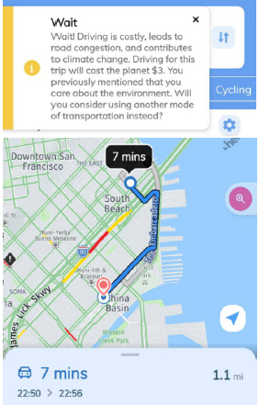
Influencing Mode Shift through Behavioral Change Strategies
TDOT Phase-2
Dr. Sabya Mishra (PI), Avani Aravind
The goal of this project, is to facilitate a meaningful shift in commuters' mode of transportation from single-occupancy vehicles (SOVs) to more sustainable alternatives. By integrating behavioral nudging techniques into a mobile application, the project aims to influence commuter behavior and promote the adoption of eco-friendly transportation options. Building on Phase I's analysis of nudging messages' impact on stated travel preferences, this project will implement and evaluate behavioral nudges within a real-world pilot study conducted within Tennessee.
Do Nudgeable travelers exist? If yes, who are they?
How can nudgeble travelers be recruited to engage in the pilot?
Which message prompts behavior change, and what level of incentive is needed?
How to scale the findings and strategies to the regional level?
Find Rides
Record Trips
Get Rewards
Transit App
Mobility options in Tennessee
Study Area (Nashville-Lebanon)
Driving is costly; would you like a more sustainable mode of travel?
Click here to explore!
Push Notification
Wait
Driving is costly, would you like to a more sustainable mode of travel?
Information Tile
Wait
Driving is costly, would you like to a more sustainable mode of travel?
Action Tile In Transit App

